Slide 1
CLIENT MANAGEMENT APP
MAUL SRI M
27/10/2025

Slide 2
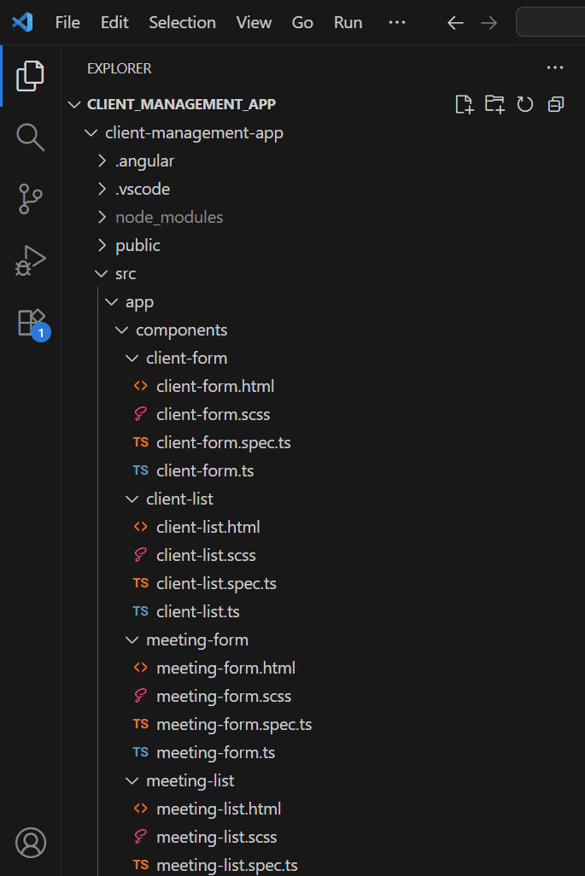
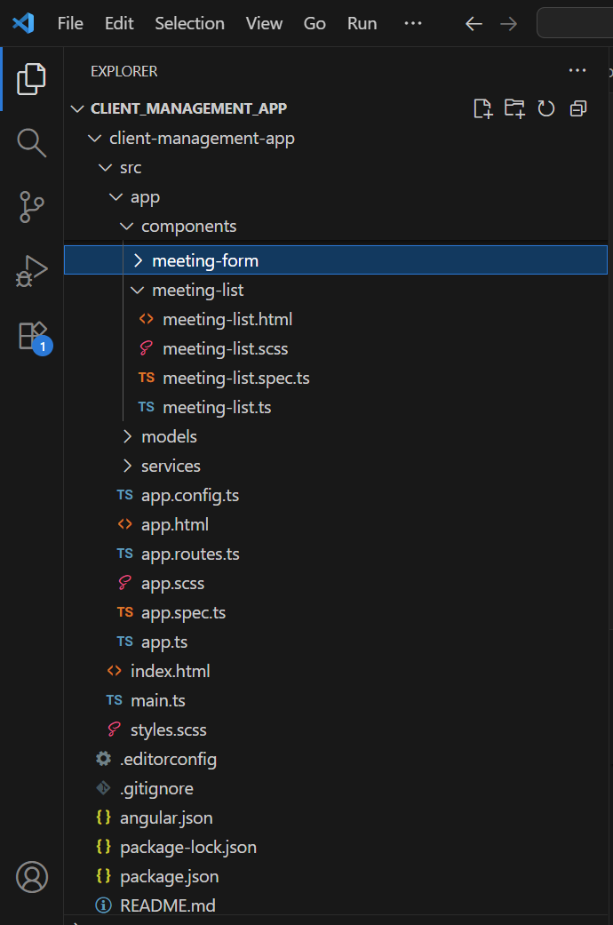
PROJECT STRUCTURE

Slide 3
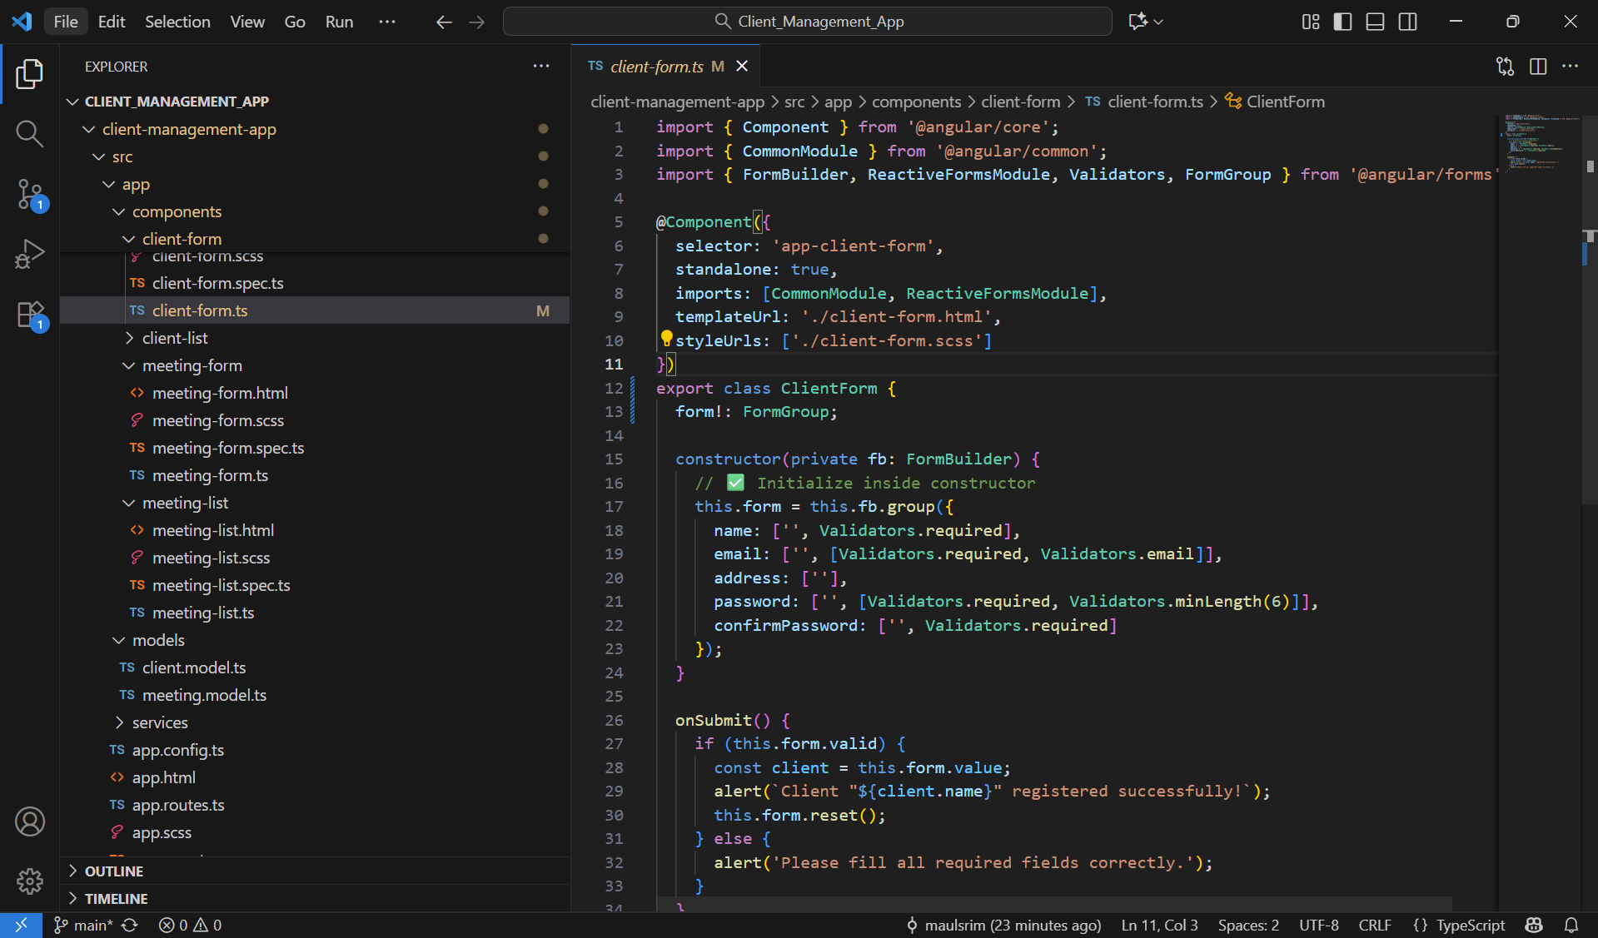
CLIENT FORM COMPONENT

Slide 4
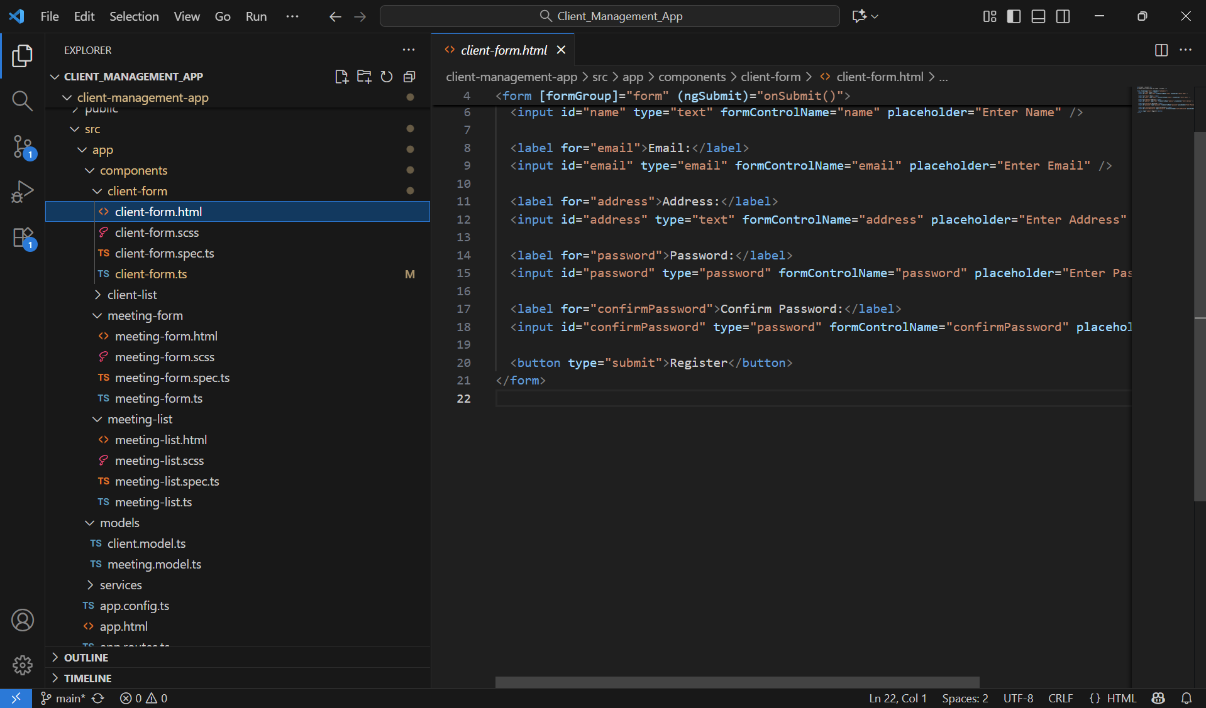
CLIENT FORM TEMPLATE

Slide 5
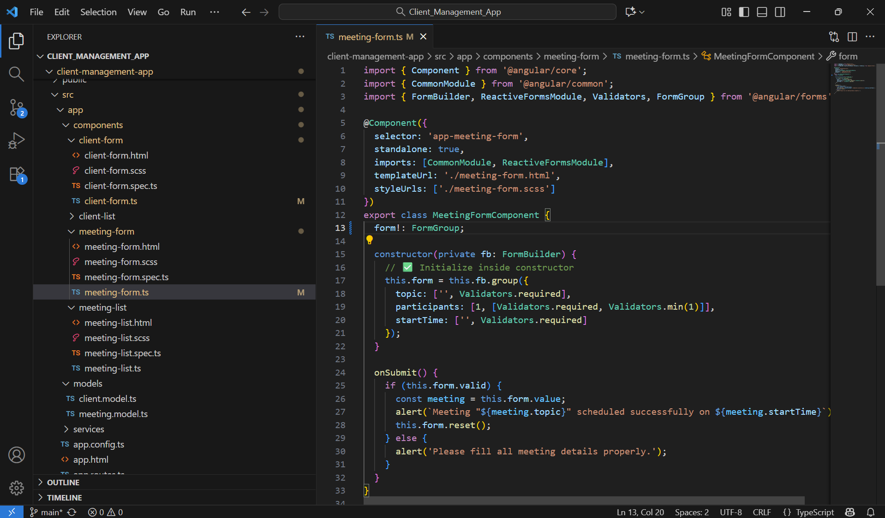
MEETING FORM COMPONENT

Slide 6
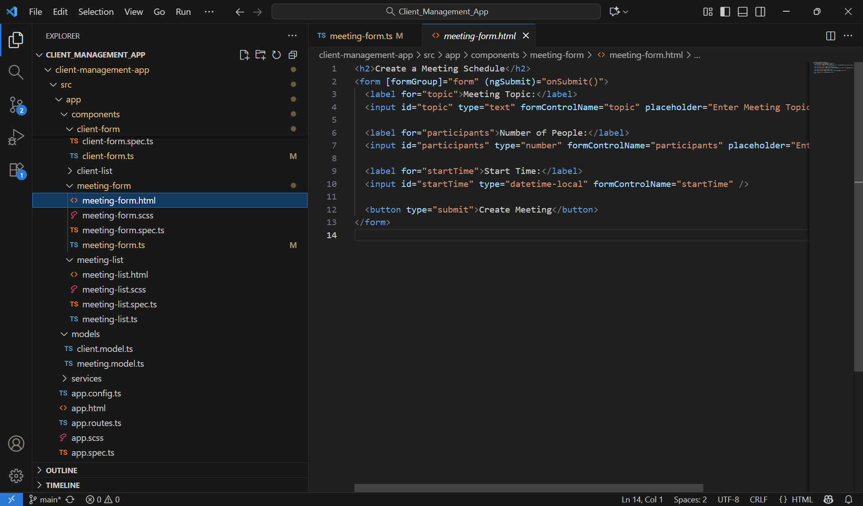
MEETING FORM TEMPLATE

Slide 7
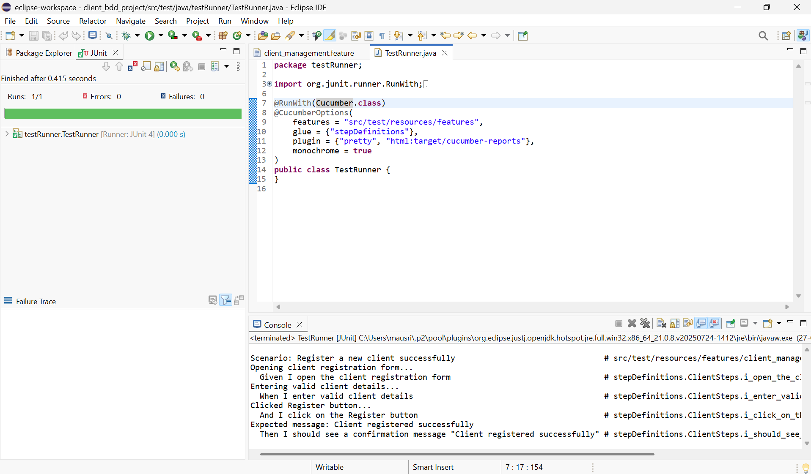
BDD

Slide 8
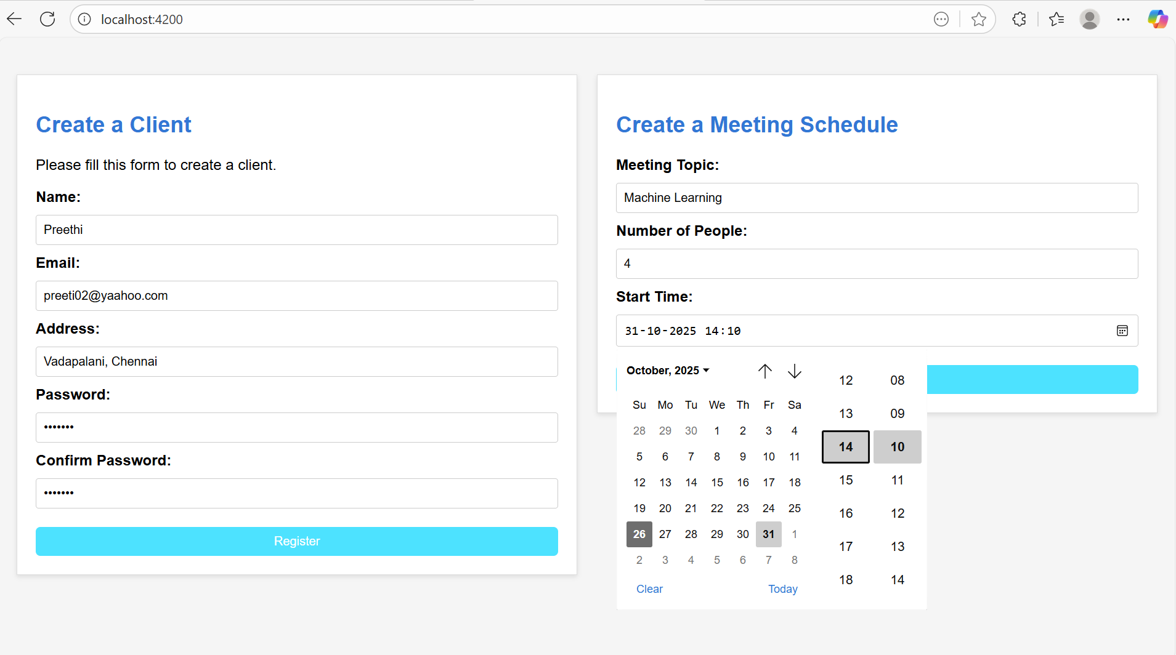
OUTPUT

Slide 9
THANK YOU

